Slide 1
Visibility

Slide 2
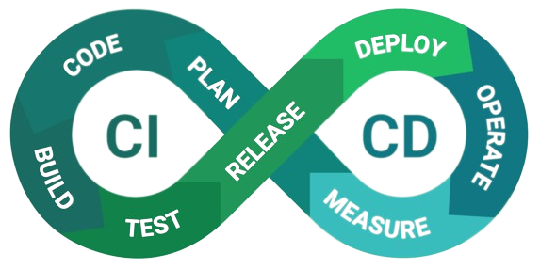
Flashback to CI/CD
How?
What?

Slide 3

Visibility in software
Some code here
Some code here
Raise exception here
Some other code
Print output here
A little more code
Send some event
…
If something goes wrong, how do I find out about it?
We need to gather some info to operate the code

Slide 4
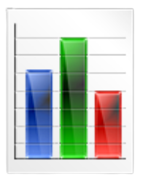



Log
Why central?
Some code here
Some code here
Raise exception here
Some other code
Print output here
A little more code
Send some event
…
Send to a central place
Process & check if needed
Gather logs

Slide 5
Node Log example
Jul 21 07:38:14 lb-haproxy-13 haproxy[1119005]: yy.yy.yy.a:60148 [21/Jul/2023:07:38:14.751] web~ web/<NOSRV> 0/-1/-1/-1/5/5/0/0 503 216 - - SC-- 17/16/0/0/0 0/0 {|kubenurse.prod.snpb.app|} "GET /alwayshappy HTTP/1.1"
Jul 21 07:38:15 lb-haproxy-13 haproxy[1119005]: yy.yy.yy.b:44186 [21/Jul/2023:07:38:15.091] web~ web/<NOSRV> 0/-1/-1/-1/4/4/0/0 503 216 - - SC-- 17/16/0/0/0 0/0 {|kubenurse.prod.snpb.app|} "GET /alwayshappy HTTP/1.1"
Jul 21 07:38:15 lb-haproxy-13 haproxy[1119005]: yy.yy.yy.c:34684 [21/Jul/2023:07:38:15.248] web~ web/<NOSRV> 0/-1/-1/-1/4/4/0/0 503 216 - - SC-- 17/16/0/0/0 0/0 {|kubenurse.prod.snpb.app|} "GET /alwayshappy HTTP/1.1"
Jul 21 07:38:15 lb-haproxy-13 haproxy[1119005]: yy.yy.yy.d:10395 [21/Jul/2023:07:38:15.317] web~ bk_noc/noc 0/0/0/101/4834/0/4717/117 200 1769064 - - ---- 16/15/6/6/0 0/0 {|noc.snpb.app|} "POST /api/datasources/1/resources/api/v1/series HTTP/1.1"
Jul 21 07:38:15 lb-haproxy-13 haproxy[1119005]: yy.yy.yy.d:30107 [21/Jul/2023:07:38:15.467] web~ bk_jenkins/jenkins 0/0/0/3/5993/0/5990/3 200 2876 - - ---- 16/15/0/0/0 0/0 {|jenkins.snpb.app|} "GET /view/IaC/job/IaC-IPSec-Restart-Tunnel/wfapi/runs?since=%23251%20-%20afshin.karimi&fullStages=true&_=1689912479532 HTTP/1.1"
Jul 21 07:38:15 lb-haproxy-13 haproxy[1119005]: yy.yy.yy.d:26864 [21/Jul/2023:07:38:15.485] web~ bk_noc/noc 0/0/0/8/3141/0/3133/8 200 233 - - ---- 16/15/8/8/0 0/0 {|noc.snpb.app|} "GET /api/annotations?from=1689908892511&to=1689912492511&limit=100&matchAny=false&dashboardId=482 HTTP/1.1"
Jul 21 07:38:15 lb-haproxy-13 haproxy[1119005]: yy.yy.yy.d:47106 [21/Jul/2023:07:38:15.473] web~ bk_noc/noc 0/0/0/59/4984/0/4910/74 200 1769064 - - ---- 16/15/8/8/0 0/0 {|noc.snpb.app|} "POST /api/datasources/1/resources/api/v1/series HTTP/1.1"
Jul 21 07:38:15 lb-haproxy-13 haproxy[1119005]: yy.yy.yy.d:40813 [21/Jul/2023:07:38:15.489] web~ bk_noc/noc 8/0/0/93/4381/0/4279/102 200 54654 - - ---- 16/15/7/7/0 0/0 {|noc.snpb.app|} "POST /api/ds/query HTTP/1.1"

Slide 6
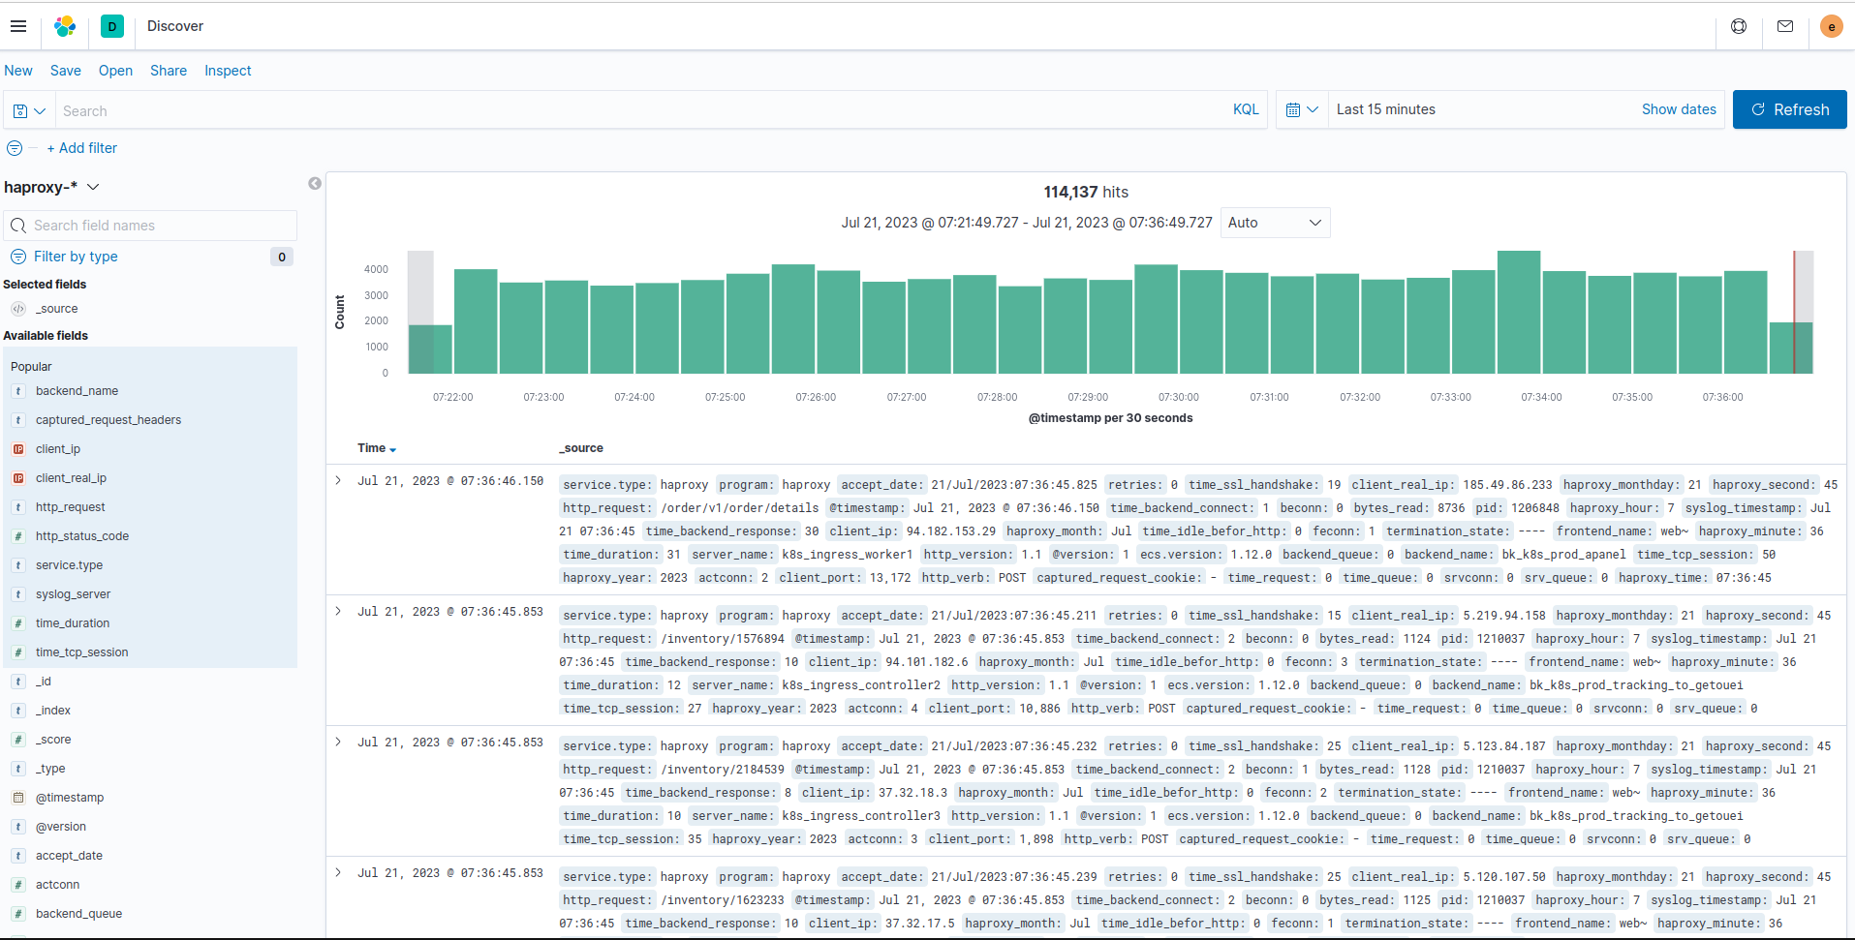
Central Log example

Slide 7
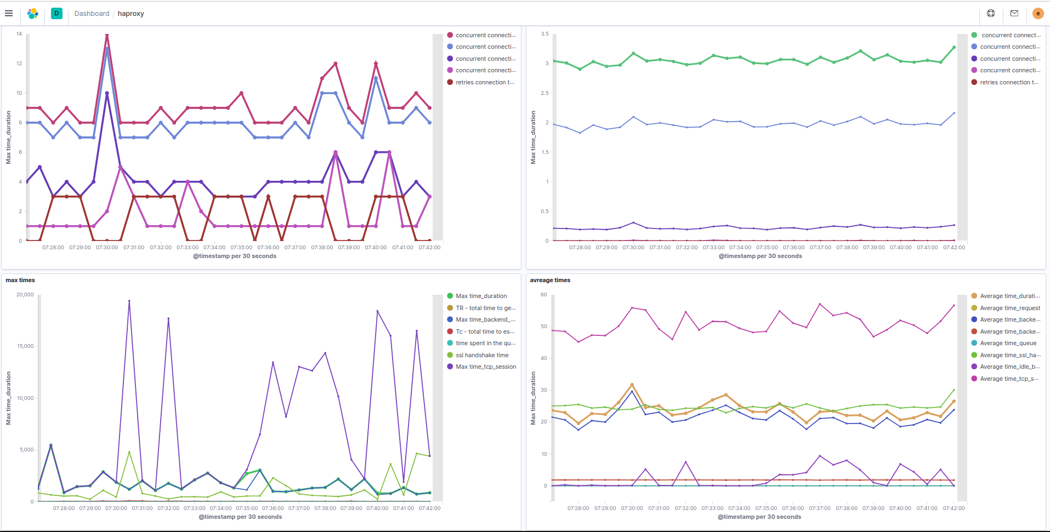
Visualized Log example

Slide 8
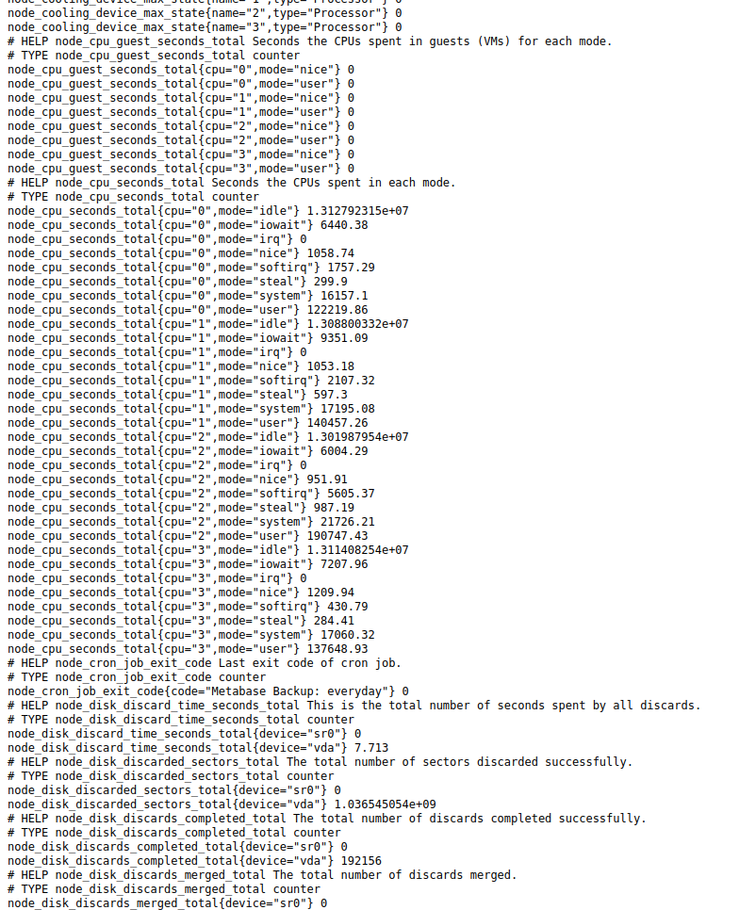

Metric
Some code here
Some code here
Raise exception here + propagate related metric
Some other code
Print output here + propagate related metric
A little more code
Send some event + propagate related metric
…

Slide 9
Node Metric example
# HELP haproxy_frontend_bytes_in_total Total number of request bytes since process started
# TYPE haproxy_frontend_bytes_in_total counter
haproxy_frontend_bytes_in_total{proxy="stats"} 384636
haproxy_frontend_bytes_in_total{proxy="stats-api"} 0
haproxy_frontend_bytes_in_total{proxy="prod_emqx_tcp"} 47305097
haproxy_frontend_bytes_in_total{proxy="prod_emqx_websocket"} 9514353
haproxy_frontend_bytes_in_total{proxy="stg_emqx_tcp"} 44
haproxy_frontend_bytes_in_total{proxy="stg_emqx_websocket"} 47
haproxy_frontend_bytes_in_total{proxy="healthcheck"} 6012
haproxy_frontend_bytes_in_total{proxy="web"} 4220
# HELP haproxy_frontend_bytes_out_total Total number of response bytes since process started
# TYPE haproxy_frontend_bytes_out_total counter
haproxy_frontend_bytes_out_total{proxy="stats"} 6490875832
haproxy_frontend_bytes_out_total{proxy="stats-api"} 0
haproxy_frontend_bytes_out_total{proxy="prod_emqx_tcp"} 12982687
haproxy_frontend_bytes_out_total{proxy="prod_emqx_websocket"} 3905328
haproxy_frontend_bytes_out_total{proxy="stg_emqx_tcp"} 0
haproxy_frontend_bytes_out_total{proxy="stg_emqx_websocket"} 66
haproxy_frontend_bytes_out_total{proxy="healthcheck"} 5832
haproxy_frontend_bytes_out_total{proxy="web"} 3840

Slide 10
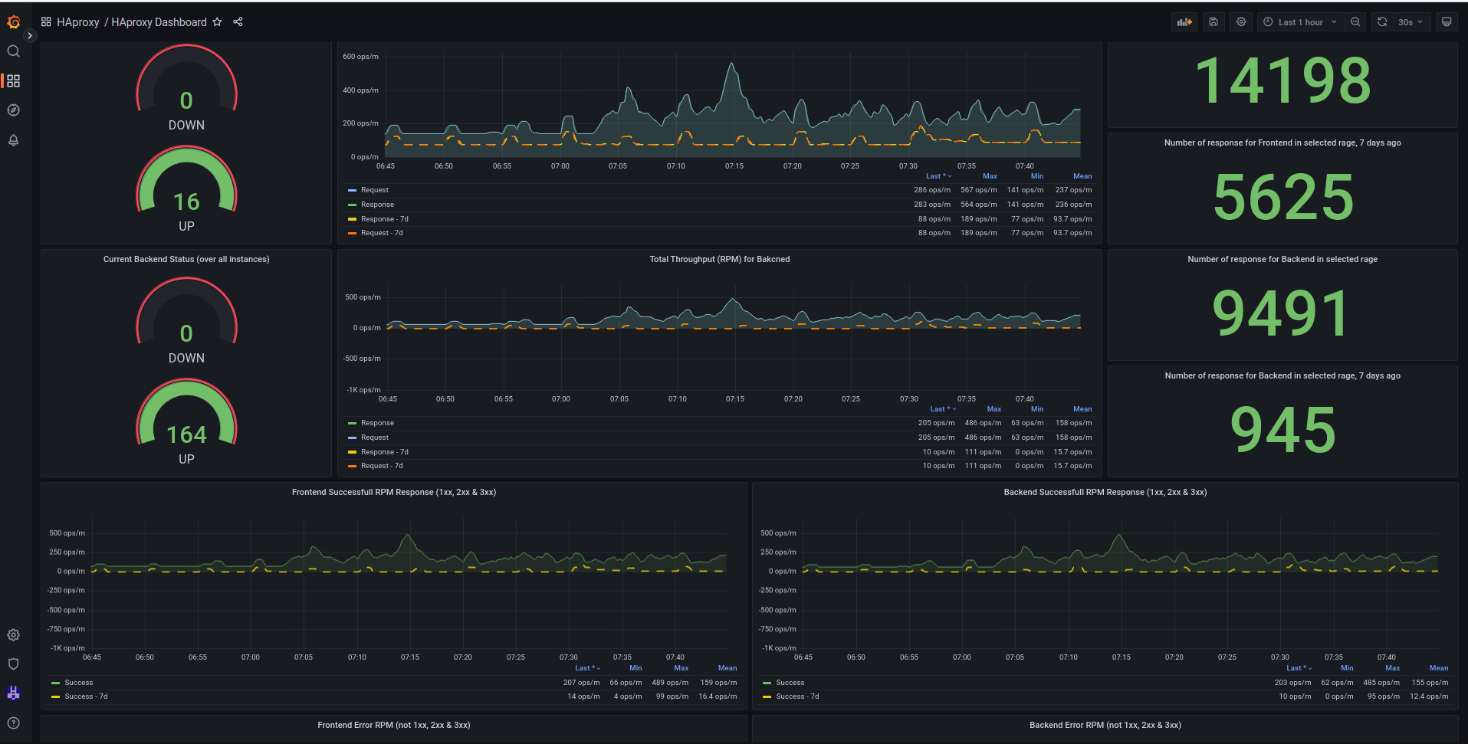
Visualized Metric example

Slide 11
Metrics vs. Log
Both of them are required.
Logs are a little hard to investigate and find any specific data; e.g. abnormal activity.
If you want, you can create a lot of dashboards from logs but its cost is higher than metrics:
CPU: for parcing/processing files
Memory: to getting ready required data
Storage: to save data, especially historical data
Use metric (which is low cost) to pinpoint the problem and the time of the problem.
Use log for that specific time, to find more details.

